Slide 1
Prototype #1 Meeting
Attendees:
Dr. Shaunn-inn Wu
Dr. Jared Macshane
Sushi Team

Slide 2
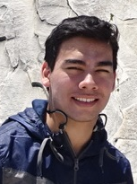
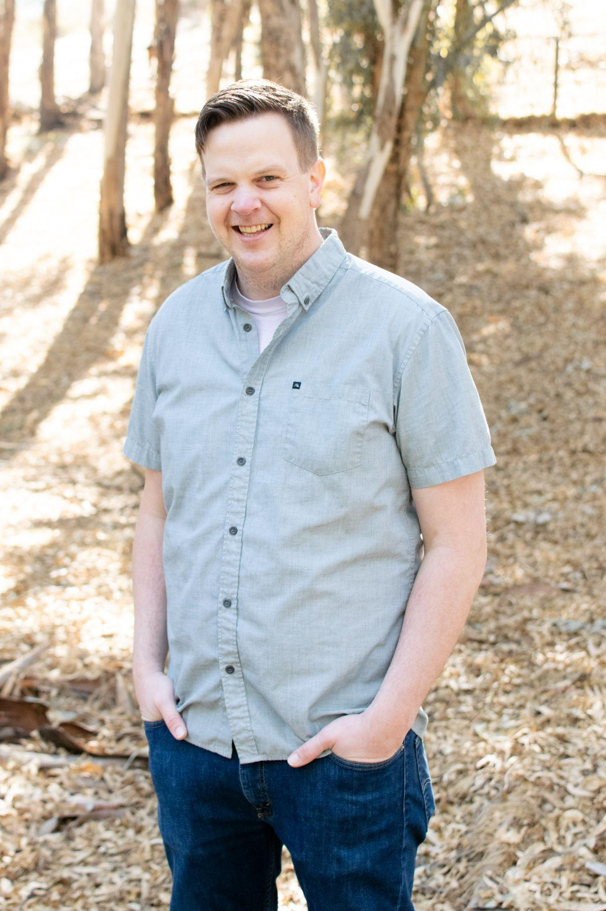

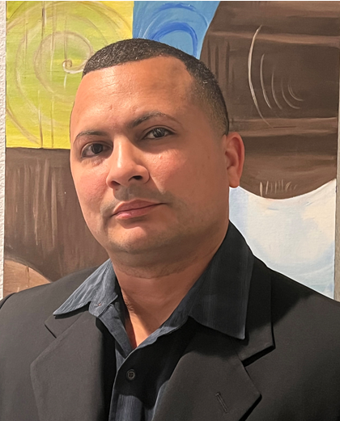
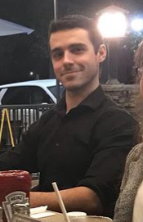
Formal Greetings
Team/Scrum Leader: Noah Miera
Programmer: Keith Gross
Project Manager: Juan Gonzalez
Programmer: Miguel Morales
Documentation/Training: Jordan Fisher

Slide 3
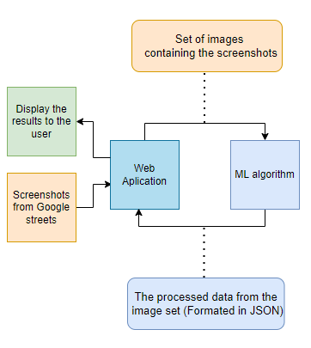
Current Requirements
As of the end of JAD 2, we are operating with the following requirements:
Develop a system to receive and process Google Street images from a user (Web App Team).
Develop a Machine Learning algorithm that must be able to detect instances of litter in the received Google Street images.
Once the litter instances have been identified, the system must then process and output the results into a suitable format, such as JSON, for the user (Web App Team).
Once the results have been made, the system must then return the processed data to the user (Web App Team).
Notes:
Go over requirements we’ve established through our JADs, and re-confirm them with Jared. (Take about 5 or more minutes, alongside the Network Diagram.)

Slide 4
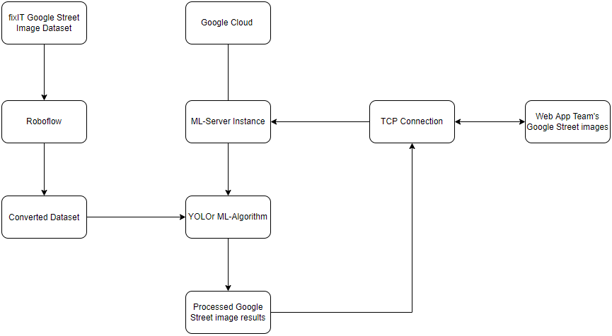
Closer View - Network Diagram
Notes:
Show/explain a more detailed System overview. Going over all thinkable variables needed for the system to work. (Take about 5 or more minutes, alongside the Current Requirements.)

Slide 5
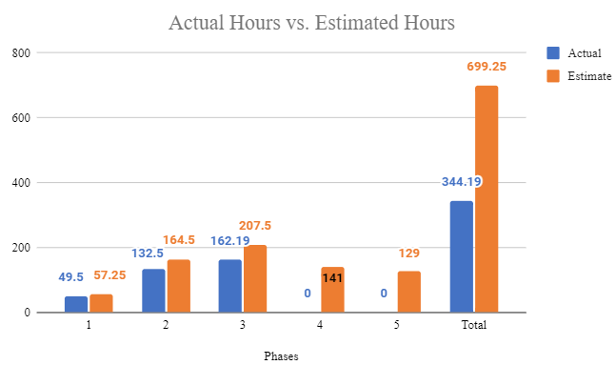
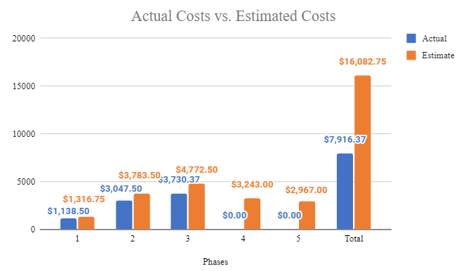
Project Management - Estimated vs Actuals
Notes:
Go over planned versus actual hours accumulated throughout this project, up to this point in Phase 3. (Take about 5 or more minutes, alongside the Prototype #1 tasks.)
Script:
Hello, I’m Juan the project manager/ Thank you Jordan
I’ll be going over the estimates vs actuals, for both Hours and Costs. The chart on the left shows the Actual vs Estimated Hours for phases 1-3 where phase 3 is still progressing as this is the current phase. In phase 1 it’s shown we accumulated 49.5 actual hours (shown as the blue bar) vs 57.25 estimated hours (shown as orange). The same is reflected on the cost chart. Costs will be based on a $23 dollar hourly wage. where phase 1 has an actual cost of $1,138.50.
In phase 1 the main objective we worked on was going over the MASK R-CNN model to gain a better understanding of it as well as machine learning concepts.
Repeat phase 2
Phase 2 shows 132.5 Estimated hours and 164.5 Actual hours reflected by a 3,047.50 estimated cost and a $3,783.50 Actual costs
In phase 2 Our team looked into the YOLORr model as we begin to decide on our new approach for the machine learning algorithm development by switching to a 2 phase model, where we first detect the litter in google street images, then, (This is conditional), categorize that litter. This 2 phase model will be better explained in future slides.
Cover phase 3
The tasks covered in our phase 3 will be discussed in the next slide.
For phases 4 and 5 we have the estimated hours as of now. An additional estimated cost is applied after labor costs for the access and utilization of a server set at $200. For our entire project we have accumulated a total cost 7,916.37 and total estimated cost of 16,082.75.
Notes:
Insert the Estimated vs Actual hours & costs bar chart in here.
Go over on the differences between the Estimated and Actuals in the 2 bar charts for each Phase.
Re-cap on notable things that happened in those Phases.
Like in Phase 1, diverting away from the single loaded image task we were given from Jared with the MASK R-CNN model.
Or in Phase 2, splitting our objective into a 2 Phase model, in which the 1st Phase will be just to identify litter in a Google Street, and the conditional 2nd Phase will be to categorize the litter.
Initially worked with R-CNN model to gain a better understanding of the fundamentals of machine learning by loading a single image through the model. We have then driven away from this.
Long term goal was to categorize litter until we realized this would create time constraints.
Re-Envisioned our main objective by splitting it into a 2 phase model where we first identify litter for phase 1 where this is our main concern and focus. The next phase is potential meaning if time permits it will then be implemented. The phase task will be to categorize the litter.
Slide Speaker notes:
Slide intro
Currently we are in the end stages of phase 3
Script:
Phase 1: Worked with RC-NN model to gain understanding.
Phase 2:
2 phase model split:
Litter detection
(provision phase) Categorization of Litter
Research and discussion on image enhancement
Formal Communication with web app team
Phase 3:
Gather Data with acceptable annotations which will be used to train using Yolor model for litter detection.
Overseeing progress with Web-app team
Part 2:
Phase 1:
Time Cost related to work hours for each member.
Phase 2:
Labor cost and server cost
Phase 2:
Labor cost and server cost

Slide 6
Project Management - Prototype #1 Tasks
Categorize Litter in Images
Annotation Software Development Through VIA
Detect Litter in Images - ML Algorithm Development
Implementing the YOLOr model for litter detection.
Detect Litter in Images - Python Script Development
Establishing a TCP pipeline between the algorithm and Web App team for Google Street images, and their processing.
ML Training
Training data using YOLOr model
ML Testing & Algorithm Processing
Additional Training, Getting/Examining results, and Initial Dataset manipulation.
ML Algorithm/Script Output Adjustments
Re-annotation to Dataset, as well pursuit towards adjustments to the Python code - such as looping the YOLOr model & unloading the model to save GPU.
162.19 Actual Hours
$ 3,730.37 Actual Costs
Notes:
Go over main/most important tasks, like what they are and the hours spent, within Phase 3. Such as training, script development, etc. (Take about 5 or more minutes, alongside the Planned vs Actual hours.)
Script:
Next I will give a recap of the main tasks within Prototype #1 that our group has Executed.
First was Categorize litter in images
We utilized Annotation software development through VIA (VGG Image Annotator). The objective of this was to give access to Dr.Shultz students to this tool with high ease of use and accessibility. Instructions were to be in order and be made available to the students to guide them setting up on their own machine and get directions of proper annotating process.
Next,
Detect Litter in images- ML Algorithim Development
Implementing the Yolor model for for litter detection
Next task is
Detect Litter in images- Where we initiate python script development based on establishing a tcp pipeline between the algorithm and the Web app team for Google Street images, and their processing.
Moving on to the
ML training - Training done using image datasets sourcing from google street. Trained using the YOLOr model.
ML Testing & Algorithm Processing- Additional Training done as well as getting/examining results, and also initial dataset manipulation.
Last objective focused on was
ML Algorithim/Script Output Adjustments - Re-Annotation to the data set was done using Annotation tool from Roboflow’s website mentioned earlier by Jordan. Adjustments to the python code were also pursued here such as looping the YOLOr model & unloading the model to save GPU power.
With these tasks we have what contributed to the 162.19 amount of Actual hours which contributed to the $3,730.37 of Actual costs in phase 3.
Notes:
Again, go over the Estimates vs the Actuals here, though just hours this time. (A chart not really needed.)
And focus more on the main tasks during this Prototype #1 Phase, and details that pertain to them.
Such main tasks would be:
Categorize Litter in Images - Annotation Software Development
Detect Litter in Images - ML Algorithm Development (First look at YOLOr)
Detect Litter in Images - Python Script Development
ML Training
ML Testing & Algorithm Processing (Additional Training, Dataset results, Initial Dataset manipulation by Keith - such as increased resolution and added buffers, integration of the Python code into the Google Cloud instance, as well as new founded value of the YOLO v5 model with polygon annotations - Keith can fill you in.
ML Algorithm/Script Output Adjustments (Re-annotation to Dataset, as well pursuit towards adjustments to the Python code - such as looping the YOLOr model & unloading the model to save GPU.

Slide 7
List of Deliverables
Machine Learning code/algorithm compatible and
usable with the Web App team.
Algorithm components:
Input of multiples Google Street images
Litter detection(YOLOR)
Bounding box & JSON output (total amount of litter)
Show accuracy/confidence level in litter prediction
Github repository: https://github.com/SushiTeam2022/KAAB-ML
Conditional feature:
Categorize the litter (e.g. Plastic bottle, Paper bag, Aluminium can ).

Slide 8
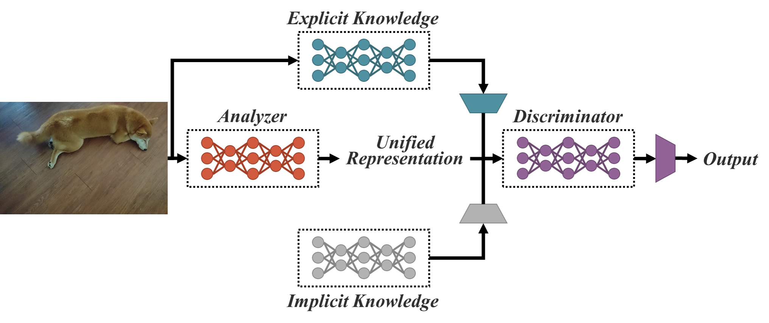
Analysis & Design
YOLOR - You Only Learn One Representation
Design
Object Detection Model
Unified Network that joins Explicit and Implicit Knowledge
Explicit Knowledge from Shallow Neural Networks
Implicit Knowledge from Deep Neural Networks
Processes
Generalization of image through Explicit Knowledge
Learn through the Generalized Image using Implicit Knowledge
Benefits
Faster detection time without loss of accuracy
Implicit Knowledge can be used for multiple tasks.
Dataset
Utilizing previous semester’s collected Google Street Images
Pre-annotated litter objects
2592 images containing 9371 annotations
Notes:
Go over our particular object detection model, YOLOr, and it’s capabilities/design/usage for our litter detection. As well as what one needs for it to work.
Also the datasets. (Take about 5 to 10 minutes, alongside the Continued Analysis & Design slide.)

Slide 9
YOLOR Requirements
Google Cloud Instance
N1-highmem-4 - Google Cloud Instance
4 vCPUs
26 GB memory
100 GB Balanced persistent disk - Storage for images and weights
NVIDIA Tesla T4 GPU - Cost Efficient GPU for machine learning
Google’s Deep Learning optimized Debian 10 image
Shared Access between group members
YOLOR
PyTorch - Machine Learning Framework based on Torch library for Tensors
Torchvision - In model image transformations and augmentations
OpenCV - Image processing and computer vision library
Weights and Biases - Online real-time hyperparameter and training monitor

Slide 10
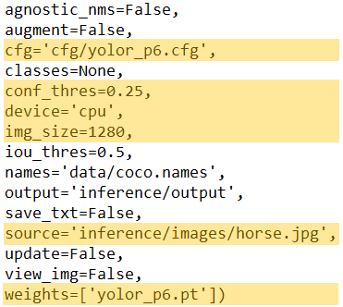
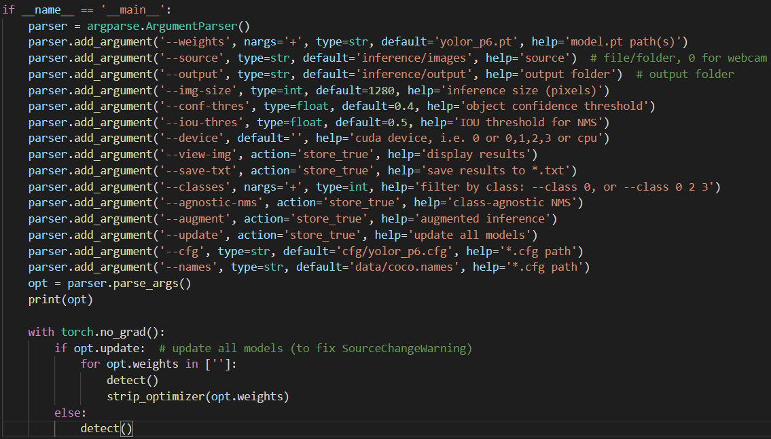
Prototype #1 Functionality - Initial Look
python detect.py --source inference/images/horses.jpg --cfg cfg/yolor_p6.cfg --weights yolor_p6.pt --conf 0.25 --img-size 1280 --device cpu
Notes:
Demonstrate functionality of the modified/newly trained YOLOr model for our litter detection. Presenting input and output. (Take about 5 to 10 minutes)

Slide 11
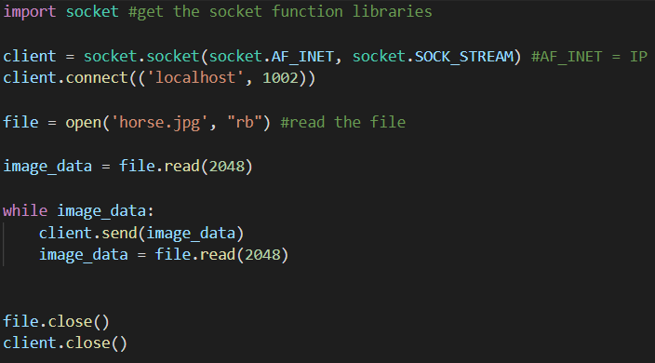
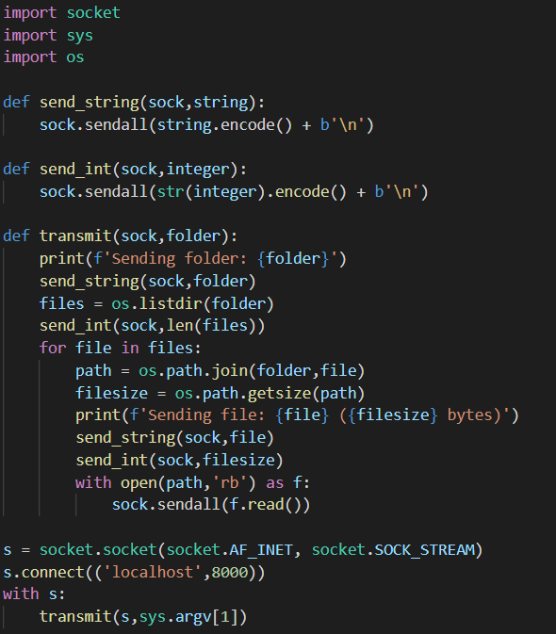
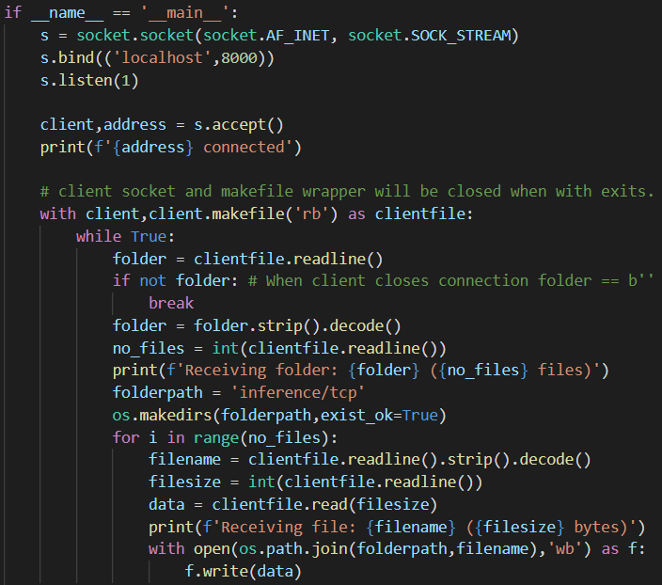
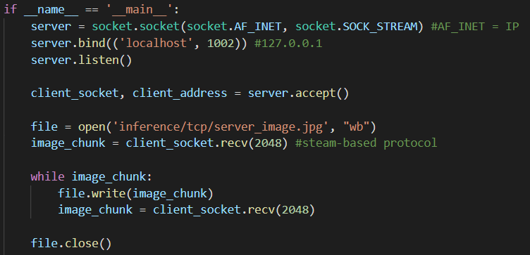
Prototype #1 Functionality - Client & Server
TCP connection: Sending a SINGLE image.
TCP connection: Sending a MULTIPLE images/contents of a folder.
$ python server.py
$ python client.py client_images

Slide 12
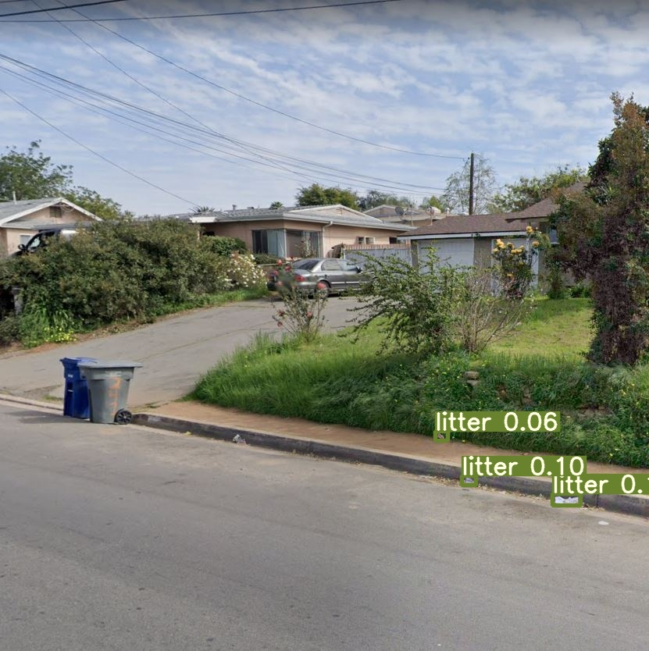
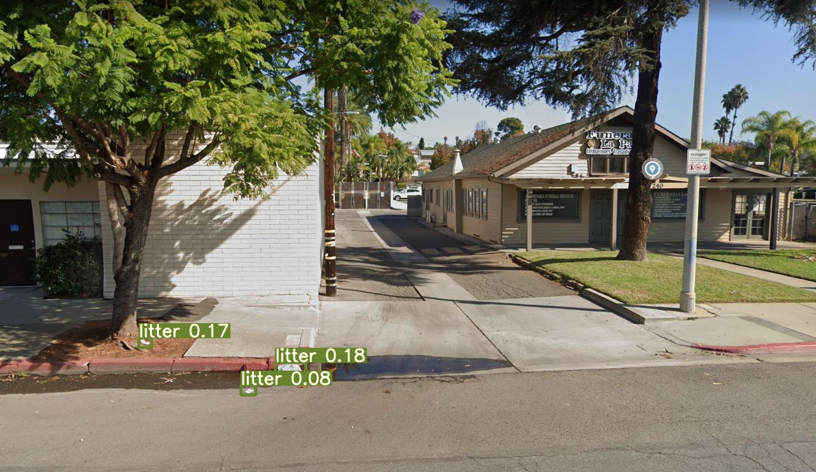
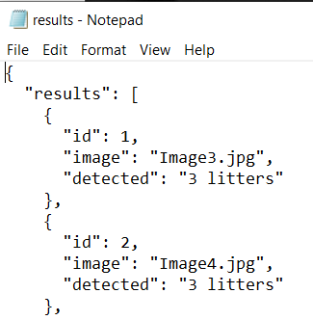

Prototype #1 Functionality - Results

Slide 13
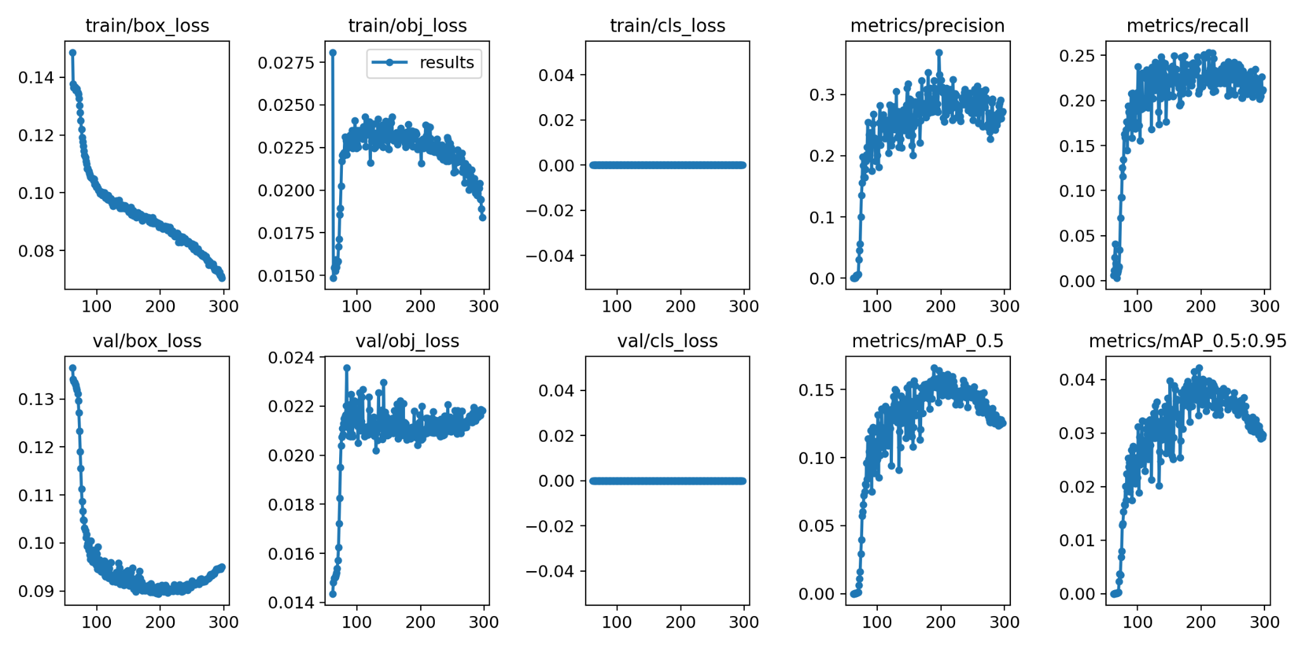
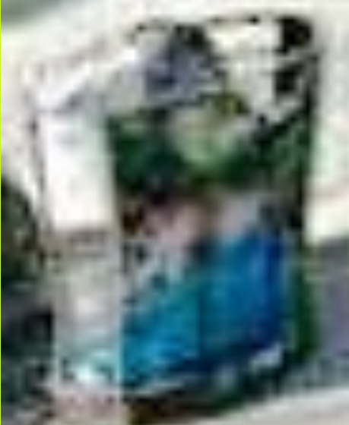
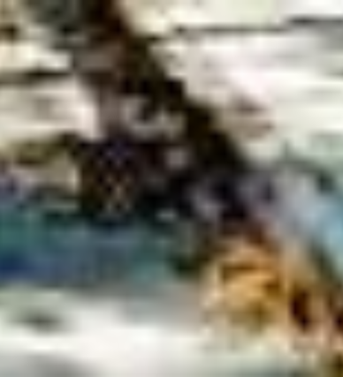

Analysis & Design - Issues
YOLOR Disadvantages
Built for Speed
Not routinely maintained
Limited to bounding box annotations
Dataset Disadvantages
Small Objects
Bounding Boxes not tight to object
Not all litter objects are annotated
Static Street Images are 640x640 px
Results
Maximum mAP@0.5 - 0.16
Low Precision and Recall
Notes:
Go over issues/limitations with the YOLOr model and datasets. (Take about 5 to 10 minutes, alongside the initial Analysis & Design slide.)

Slide 14
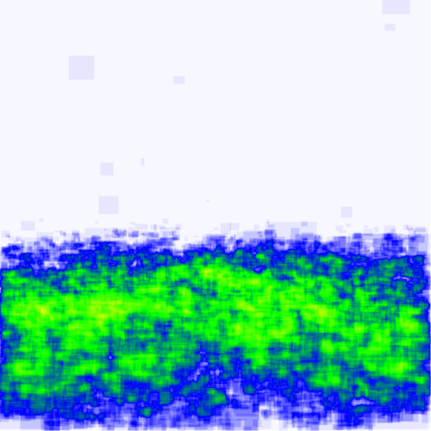
Solutions
Improved Street Image Collection Parameters
Tighter FOV
Downward Pitch
Re-annotation of existing dataset
Using Roboflow annotation functionality
YOLOv5 model
Polygon to Bounding Box transformation
Better Auto Anchor regeneration
Higher Precision though slightly slower
Export tool for Weights into other formats
Annotation Heat Map

Slide 15
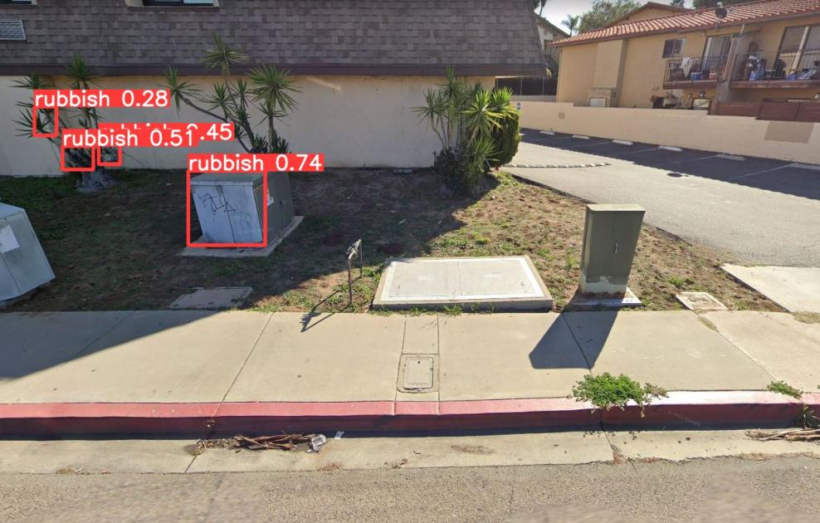
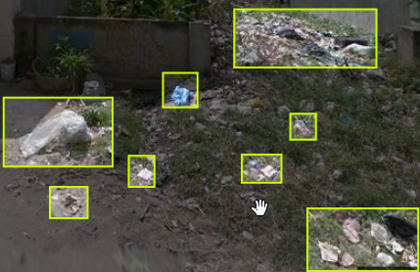
Final Thoughts and Goals
Progress:
New Images Sources, due to poor resolution
Other sources: Covered multiples angles/too much variety in images for image collection.
Stick with Google Street.
New annotations, due to poor annotations
Other sources: Were not compatible with Google Street images.
Re-annotation previous dataset to provide better accuracy
Standardized the annotation tool from Roboflow to use in the project (Required account)
Additional dataset (10,000 images) and annotations required for better results. Working with Web App team and Dr. Schultz’s students.
Next Objective:
Litter detection -> Continue in YOLOr
Refinement of what we have
Litter categorization -> Migration to a different model (Perhaps YOLOv5?)
Classes (paper, plastic, aluminium, etc…)
……………………………………………………………………………………
..
Moving with yoloR model
Training is been conducted
Input/Output
Goal
Next phase
categorization
Notes:
Draw out thoughts about our current progress, how we’ll adapt to our current issues, and our further goals/decisions till the next Prototype session. (Take about 5 or more minutes.)
Go over on how we’ve tried to, and what we’re doing now, to adapt to our current issues.
(Such as finding different sources of images, trying to increase Google Street image resolution and add buffers to them - ask Keith about, as well as re-annotating the previous groups dataset.)
Be sure to go in detail, like how Roboflow has that annotation helper, and how it works.
Recap our current progress, as well as current direction with the Web App team (such as the 10,000 Google Street images), and Dr. Schultz’s students (who will annotate the new images on Roboflow - which we’ll be able to see/approve of.
(Again, ask Keith about stuff with Roboflow, and Jordan about stuff with the Web App team.)
Then question on how it all appeals towards Jared, as well as confirm and agree upon our direction for the next Phase, either towards refinement on what we have (with YOLOr), or to start adapting towards the categorizing of litter (through YOLO v5), or both.M

Slide 16
Feedback & Questions?
Notes:
Receive feedback, uncover further requirements, modify list of deliverables, and modify project scope. (Should take about 15 or so minutes.)

